Slide 1
Digital communication
Lab-2
B.Tech II CS
(A+B)

Slide 2
Aim
To examine sampling and reconstruction of signal, verify the Nyquist criteria by varying sampling frequency. Draw the sampled version of waveform for the conditions:
(i) fs < 2fm, (ii) fs > 2fm and (iii) fs = 2fm; where fs - sampling frequency; fm - maximum baseband frequency and represent the output responses for different order low pass filter. Use virtual mode with appropriate software.

Slide 3
SAMPLING THEOREM:
Sampling is a process that converts continuous signal into discrete time signal. Discrete signal is then quantized to digital signal using Quantization.
A Band-Limited continuous time signal can be represented by its samples and can be recovered back when sampling frequency fs is greater than or equal to the twice the highest frequency component of message signal.

Slide 4
Over-sampling:
Over-sampling occurs when the sampling frequency is greater than twice the frequency of message signal. In over-sampling, we can reconstruct the original signal.
fs > 2fm
Perfect-sampling:
Perfect-sampling occurs when the sampling frequency is equal to twice the frequency of message signal. In perfect-sampling, we can reconstruct the original signal.
fs = 2fm
Under-sampling:
Under-sampling occurs when the sampling frequency is less than twice the frequency of message signal. In perfect-sampling, we can’t reconstruct the original signal.
fs < 2fm

Slide 5
Introduction to MATLAB
MATLAB is basically a high level language which has many specialized toolboxes for making things easier for us
Matlab
High Level
Languages such as
C, Pascal etc.
Assembly

Slide 6
What are we interested in?
Matlab is too broad for our purposes in this course.
The features we are going to require is
Matlab
Series of Matlab commands
m-files
Command
Line
mat-files
functions
Command execution like DOS command window
Data storage/ loading
Input
Output
capability

Slide 7
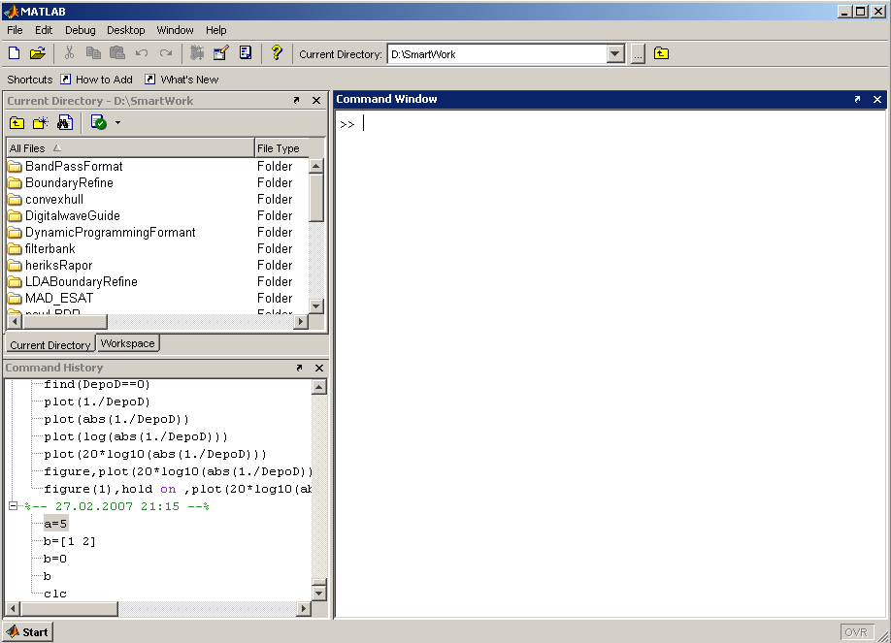
Matlab Screen
Command Window
type commands
Current Directory
View folders and m-files
Workspace
View program variables
Double click on a variable
to see it in the Array Editor
Command History
view past commands
save a whole session
using diary

Slide 8
Variables
No need for types. i.e.,
All variables are created with double precision unless specified and they are matrices.
After these statements, the variables are 1x1 matrices with double precision
int a;
double b;
float c;
Example:
>>x=5;
>>x1=2;

Slide 9
Array, Matrix
a vector x = [1 2 5 1]
x =
1 2 5 1
a matrix x = [1 2 3; 5 1 4; 3 2 -1]
x =
1 2 3
5 1 4
3 2 -1
transpose y = x’ y =
1
2
5
1

Slide 10
Long Array, Matrix
t =1:10
t =
1 2 3 4 5 6 7 8 9 10
k =2:-0.5:-1
k =
2 1.5 1 0.5 0 -0.5 -1
B = [1:4; 5:8]
x =
1 2 3 4
5 6 7 8

Slide 11
Generating Vectors from functions
zeros(M,N) MxN matrix of zeros
ones(M,N) MxN matrix of ones
rand(M,N) MxN matrix of uniformly distributed random
numbers on (0,1)
x = zeros(1,3)
x =
0 0 0
x = ones(1,3)
x =
1 1 1
x = rand(1,3)
x =
0.9501 0.2311 0.6068

Slide 12
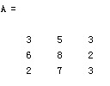
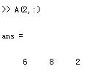



Matrix Index
The matrix indices begin from 1 (not 0 (as in C))
The matrix indices must be positive integer
Given:
A(-2), A(0)
Error: ??? Subscript indices must either be real positive integers or logicals.
A(4,2)
Error: ??? Index exceeds matrix dimensions.

Slide 13
Concatenation of Matrices
x = [1 2], y = [4 5], z=[ 0 0]
A = [ x y]
1 2 4 5
B = [x ; y]
1 2
4 5
C = [x y ;z]
Error:
??? Error using ==> vertcat CAT arguments dimensions are not consistent.

Slide 14
Operators (arithmetic)
+ addition
- subtraction
* multiplication
/ division
^ power
‘ complex conjugate transpose

Slide 15
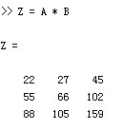
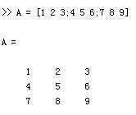
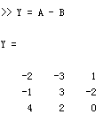
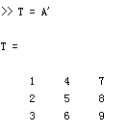
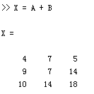
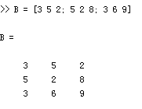
Matrices Operations
Given A and B:
Addition
Subtraction
Product
Transpose

Slide 16
Operators (Element by Element)
.* element-by-element multiplication
./ element-by-element division
.^ element-by-element power

Slide 17
The use of “.” – “Element” Operation
A = [1 2 3; 5 1 4; 3 4 1]
A =
1 2 3
5 1 4
3 4 -1
b = x .* y
b=
3 8 -3
c = x . / y
c=
0.33 0.5 -3
d = x .^2
d=
1 4 9
x = A(1,:)
x=
1 2 3
y = A(3 ,:)
y=
3 4 -1
K= x^2
Erorr:
??? Error using ==> mpower Matrix must be square.
B=x*y
Erorr:
??? Error using ==> mtimes Inner matrix dimensions must agree.

Slide 18
Basic Task: Plot the function sin(x) between 0≤x≤4π
Create an x-array of 100 samples between 0 and 4π.
Calculate sin(.) of the x-array
Plot the y-array
>>x=linspace(0,4*pi,100);
>>y=sin(x);
>>plot(y)

Slide 19
Plot the function e^{-x/3}sin(x) between 0≤x≤4π
Create an x-array of 100 samples between 0 and 4π.
Calculate sin(.) of the x-array
Calculate e^{-x/3} of the x-array
Multiply the arrays y and y1
>>x=linspace(0,4*pi,100);
>>y=sin(x);
>>y1=exp(-x/3);
>>y2=y*y1;

Slide 20
Plot the function e^{-x/3}sin(x) between 0≤x≤4π
Multiply the arrays y and y1 correctly
Plot the y2-array
>>y2=y.*y1;
>>plot(y2)

Slide 21
Display Facilities
plot(.)
stem(.)
Example:
>>x=linspace(0,4*pi,100);
>>y=sin(x);
>>plot(y)
>>plot(x,y)
Example:
>>stem(y)
>>stem(x,y)

Slide 22
Display Facilities
title(.)
xlabel(.)
ylabel(.)
>>title(‘This is the sinus function’)
>>xlabel(‘x (secs)’)
>>ylabel(‘sin(x)’)

Slide 23
Operators (relational, logical)
== Equal to
~= Not equal to
< Strictly smaller
> Strictly greater
<= Smaller than or equal to
>= Greater than equal to
& And operator
| Or operator

Slide 24
Flow Control
if
for
while
break
….

Slide 25
Control Structures
Some Dummy Examples
if ((a>3) & (b==5))
Some Matlab Commands;
end
if (a<3)
Some Matlab Commands;
elseif (b~=5)
Some Matlab Commands;
end
if (a<3)
Some Matlab Commands;
else
Some Matlab Commands;
end
If Statement Syntax
if (Condition_1)
Matlab Commands
elseif (Condition_2)
Matlab Commands
elseif (Condition_3)
Matlab Commands
else
Matlab Commands
end

Slide 26
Control Structures
For loop syntax
for i=Index_Array
Matlab Commands
end
Some Dummy Examples
for i=1:100
Some Matlab Commands;
end
for j=1:3:200
Some Matlab Commands;
end
for m=13:-0.2:-21
Some Matlab Commands;
end
for k=[0.1 0.3 -13 12 7 -9.3]
Some Matlab Commands;
end

Slide 27
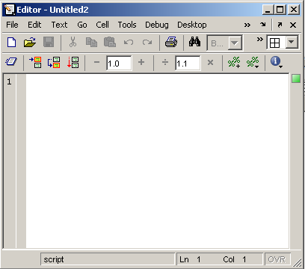
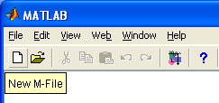
Use of M-File
Click to create a new M-File
Extension “.m”
A text file containing script or function or program to run

Slide 28
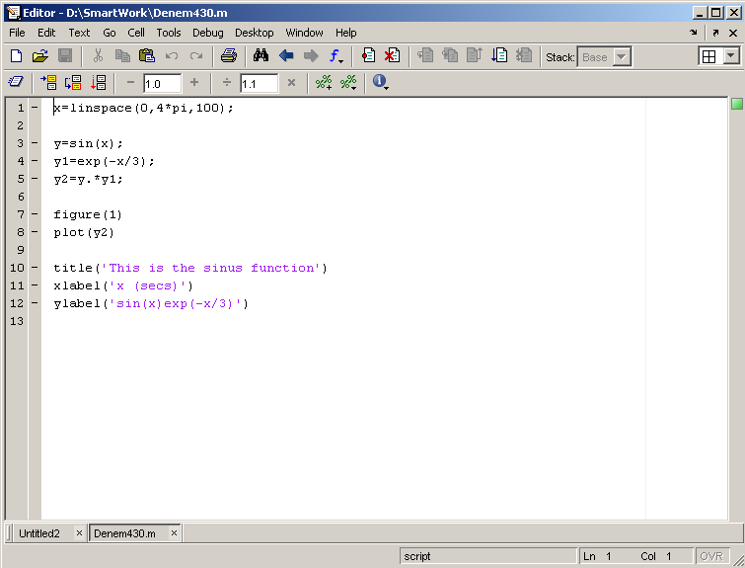
Use of M-File
Save file as Denem430.m
If you include “;” at the
end of each statement,
result will not be shown
immediately

Slide 29
Writing User Defined Functions
Functions are m-files which can be executed by specifying some inputs and supply some desired outputs.
The code telling the Matlab that an m-file is actually a function is
You should write this command at the beginning of the m-file and you should save the m-file with a file name same as the function name
function out1=functionname(in1)
function out1=functionname(in1,in2,in3)
function [out1,out2]=functionname(in1,in2)

Slide 30
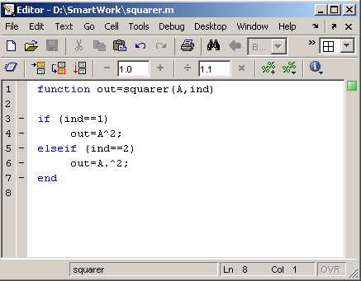
Writing User Defined Functions
Examples
Write a function : out=squarer (A, ind)
Which takes the square of the input matrix if the input indicator is equal to 1
And takes the element by element square of the input matrix if the input indicator is equal to 2
Same Name

Slide 31
Notes:
“%” is the neglect sign for Matlab (equaivalent of “//” in C). Anything after it on the same line is neglected by Matlab compiler.
Sometimes slowing down the execution is done deliberately for observation purposes. You can use the command “pause” for this purpose
pause %wait until any key
pause(3) %wait 3 seconds

Slide 32
Useful Commands
The two commands used most by Matlab
users are
>>help functionname
>>lookfor keyword

Slide 33
ALGORITHM
1. Define analog frequency fa for the input sinusoidal signal and also choose sampling frequency much greater than fa. Let k be the scaling factor
2. Define the time period n as per the sampling frequency and plot the sampled signal using this time period.
3. Define the reconstruction time period and reconstructed output vector.
4. Multiply the sampled signal with sinc pulse at various sampling instants and accumulate all the values to obtain reconstructed signal.
5. Choose different frequencies and repeat the same.

